Slide 1
Pareto Comparison Plots

Slide 2
ZDT1 Problem

Slide 3
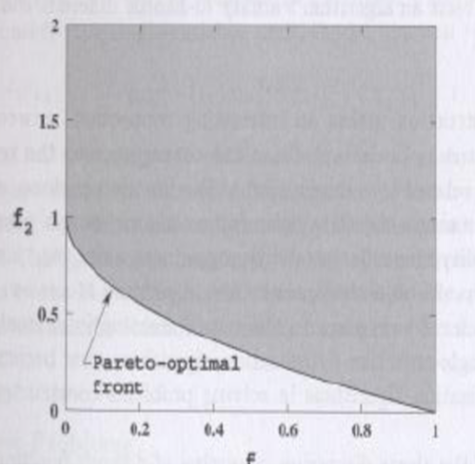
ZDT1
GOAL
Achieved

Slide 4
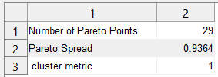
ZDT1

Slide 5
ZDT2 Problem

Slide 6
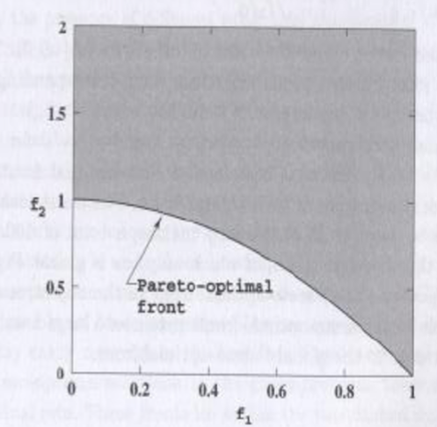
ZDT2
GOAL
Achieved

Slide 7
ZDT2

Slide 8
ZDT3 Problem

Slide 9
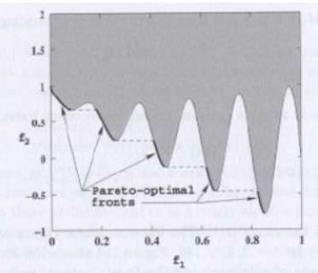
ZDT3
GOAL
Achieved

Slide 10
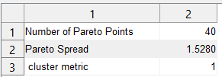
ZDT3

Slide 11
OSY Problem

Slide 12
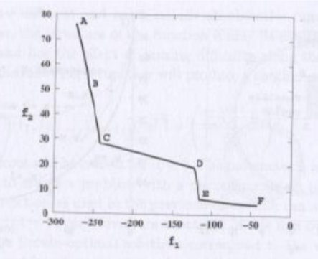
OSY
GOAL
Achieved

Slide 13

OSY

Slide 14
CTP Problem

Slide 15
CTP
GOAL
Achieved

Slide 16

CTP

Slide 17
TNK Problem

Slide 18
TNK
GOAL
Achieved

Slide 19

TNK

Slide 20
TNK MORO Problem

Slide 21
TNK MORO
GOAL
Achieved

Slide 22
TNK MORO

